Slide 1

Chapter 12
Multiple Access
Copyright © The McGraw-Hill Companies, Inc. Permission required for reproduction or display.

Slide 2
Link Layer and LANs
Link layer services:
Error detection
errors caused by signal attenuation, noise.
receiver detects presence of errors signals sender for retransmission or drops frame
Error correction
receiver identifies and corrects bit error(s) without resorting to retransmission
Flow control
pacing between adjacent sending and receiving nodes
Framing - link layer addressing
Sharing a broadcast/multipoint link : Multiple access

Slide 3
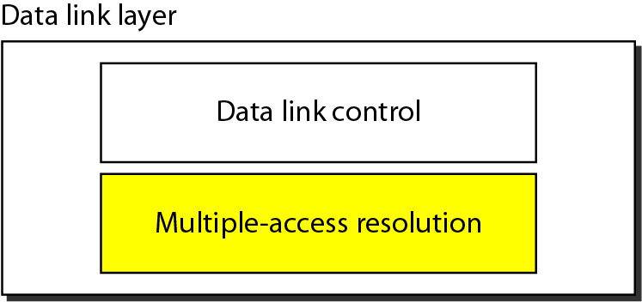
Figure 12.1 Data link layer divided into two functionality-oriented sublayers

Slide 4
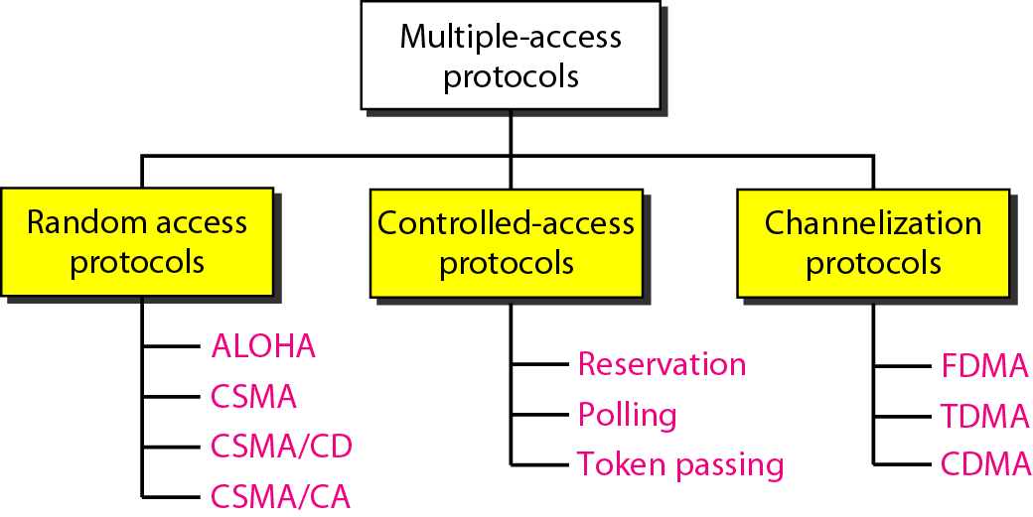
Figure 12.2 Taxonomy of multiple-access protocols discussed in this chapter

Slide 5
12-1 RANDOM ACCESS
In random access or contention methods, no station is superior to another station and none is assigned the control over another. No station permits, or does not permit, another station to send. At each instance, a station that has data to send uses a procedure defined by the protocol to make a decision on whether or not to send.
Topics discussed in this section:
ALOHA Carrier Sense Multiple Access
Carrier Sense Multiple Access with Collision Detection
Carrier Sense Multiple Access with Collision Avoidance

Slide 6
12-1-1 ALOHA
The earliest random access method
Was developed at the University of Hawaii
Has two variants:
Pure ALOHA
Slotted ALOHA

Slide 7
PURE ALOHA
The original ALOHA protocol
Each station sends a frame whenever it has a frame to send
Since there is only one channel to share, there is the possibility of collision between frames from different stations

Slide 8
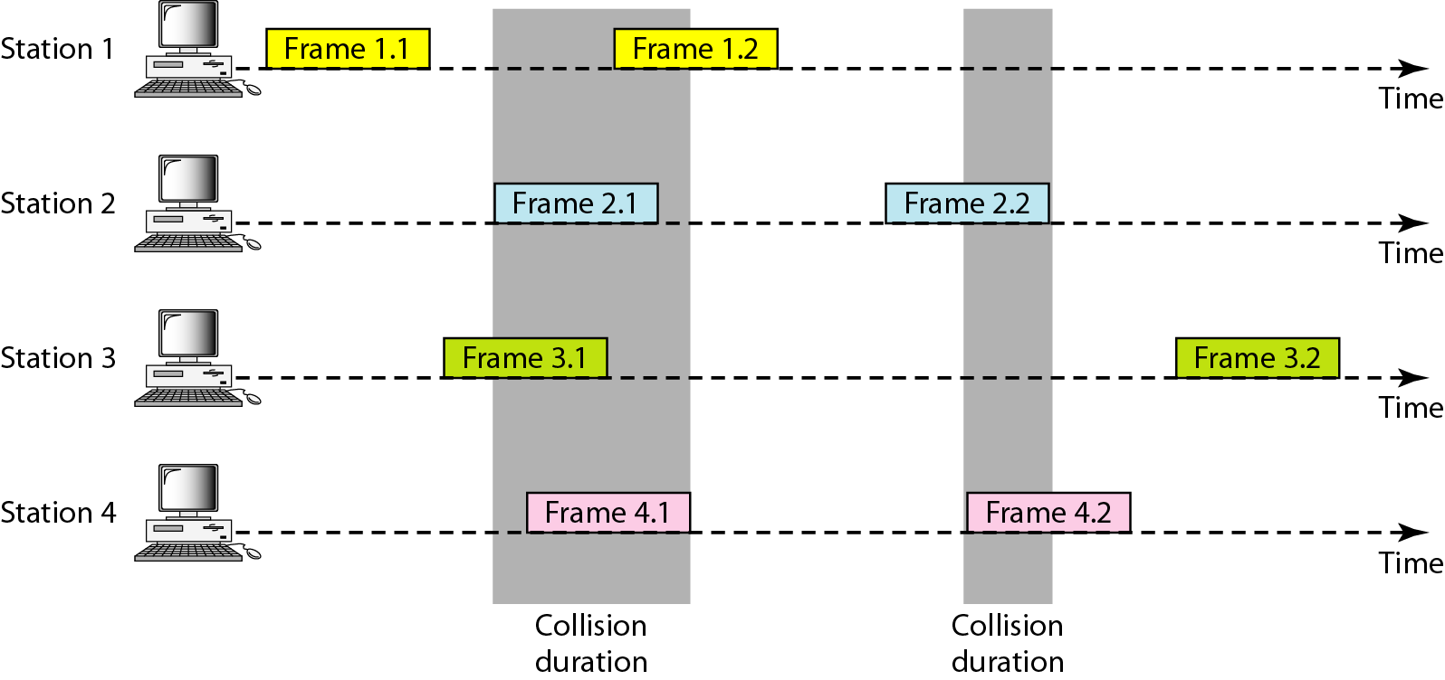
Figure 12.3 Frames in a pure ALOHA network

Slide 9
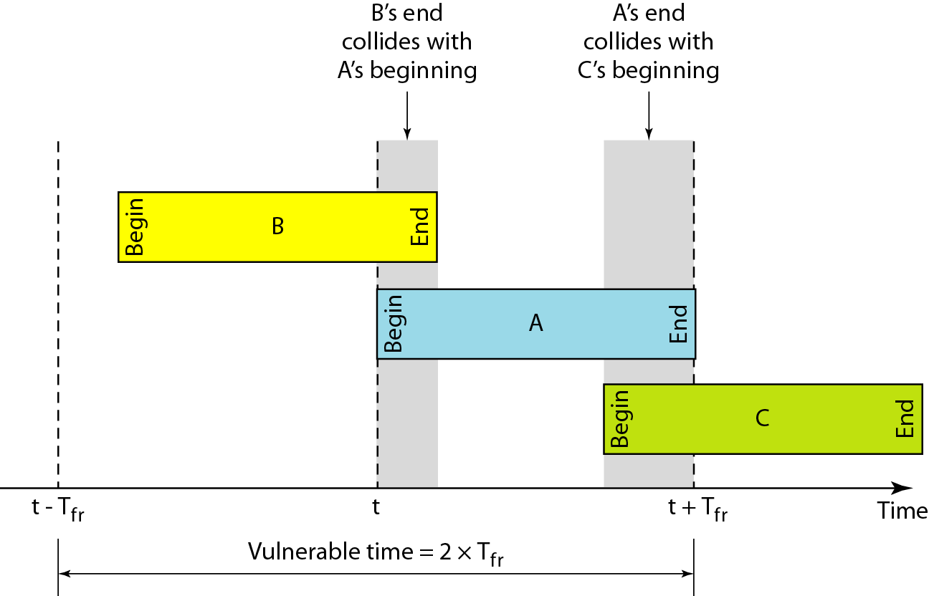
Figure 12.5 Vulnerable time for pure ALOHA protocol

Slide 10
SLOTTED ALOHA
In slotted ALOHA the time is divided into slots of T_{fr} seconds
Stations can send frames only at the beginning of the time slot
Improves the efficiency of pure ALOHA

Slide 11
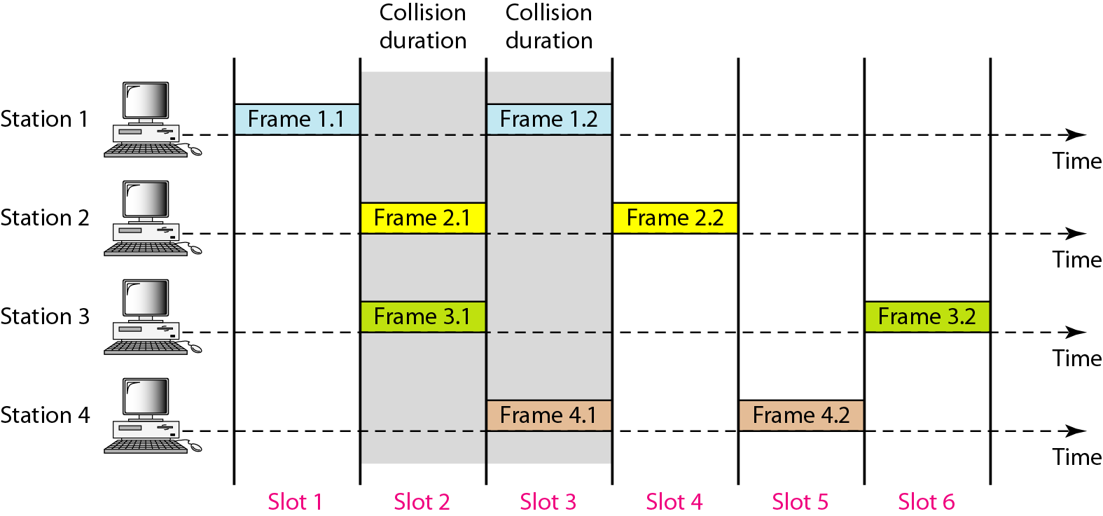
Figure 12.6 Frames in a slotted ALOHA network

Slide 12
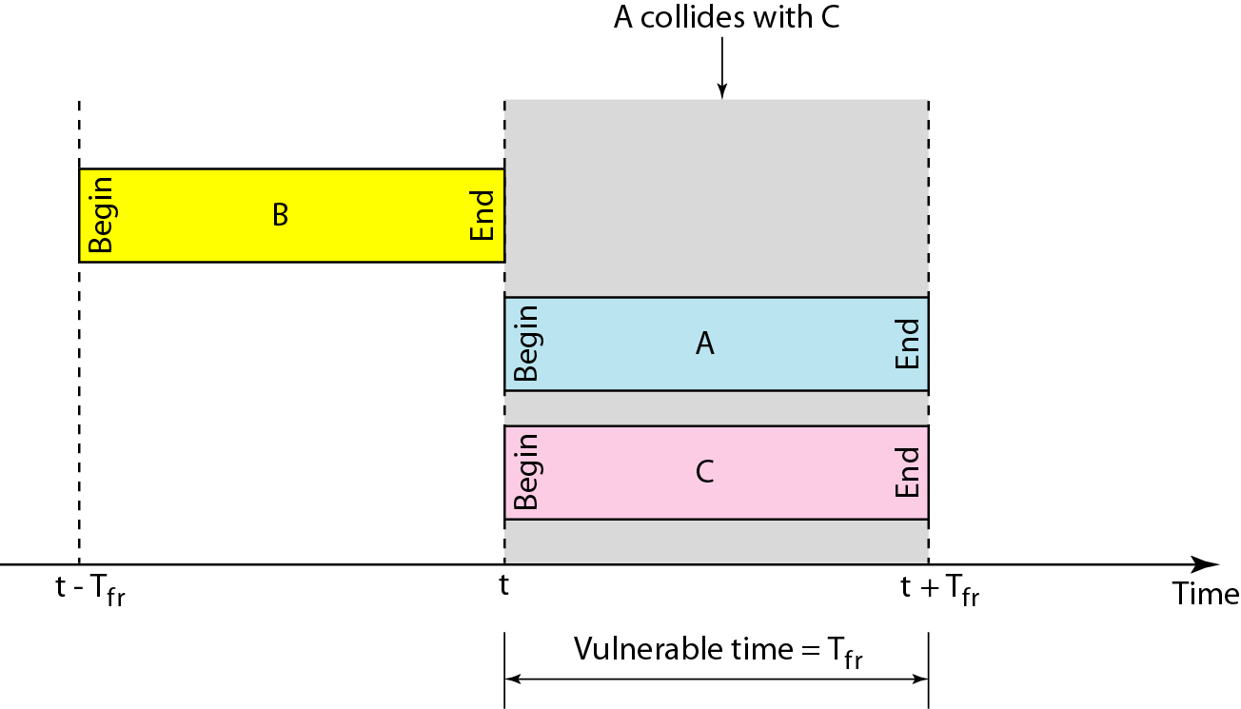
Figure 12.7 Vulnerable time for slotted ALOHA protocol

Slide 13
12-1-2 CSMA
Carrier Sense Multiple Access
Senses the medium before sending frame
Reduce the possibility of collision, but it cannot eliminate it due to propagation delay

Slide 14
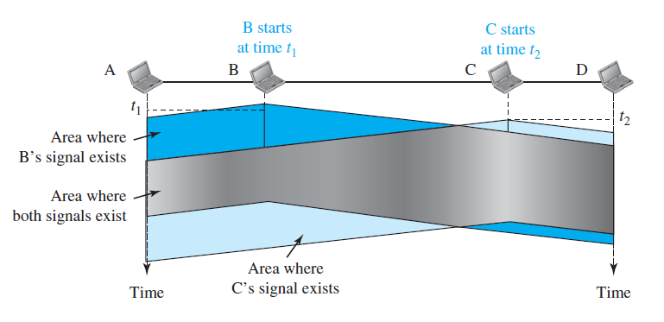
Figure 12.8 Space/time model of a collision in CSMA

Slide 15
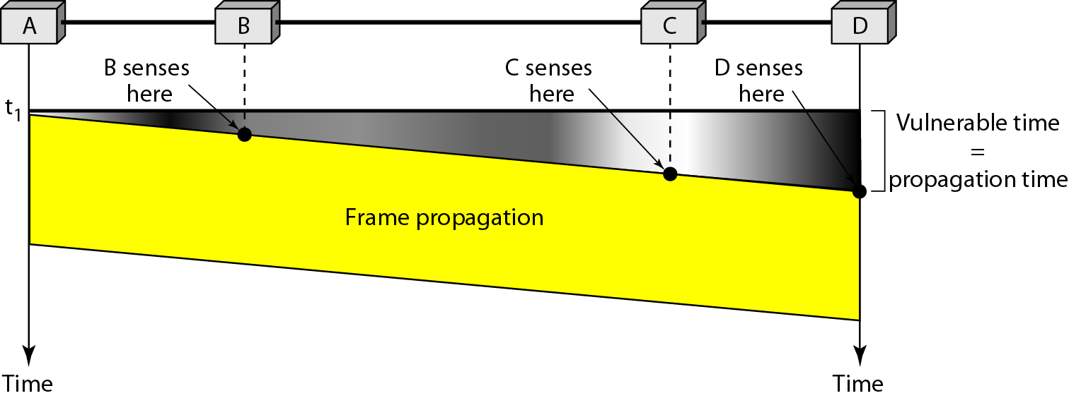
Figure 12.9 Vulnerable time in CSMA

Slide 16
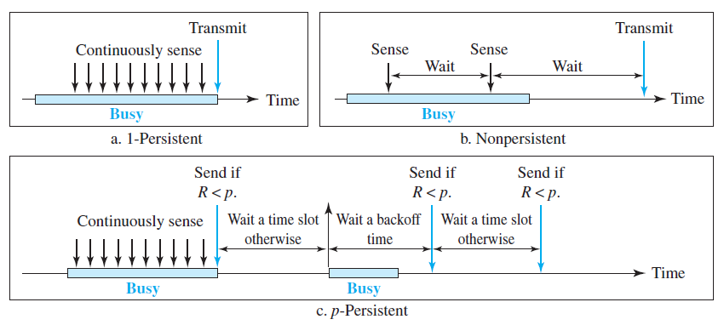
Figure 12.10 Behavior of three persistence methods of CSMA

Slide 17
12-1-3 CSMA/CD
Carrier Sense Multiple Access with Collision Detection
The CSMA method does not specify the procedure following a collision
CSMA/CD augments the algorithm to handle the collision
The medium is monitored continuously by each station
If there is a collision,
Immediately aborts transmission
The frame is sent again

Slide 18
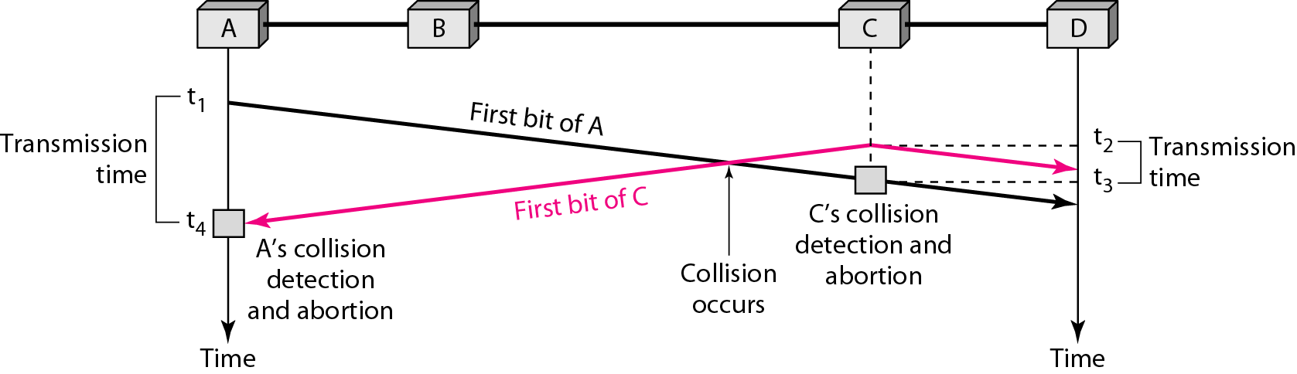
Figure 12.12 Collision of the first bit in CSMA/CD

Slide 19
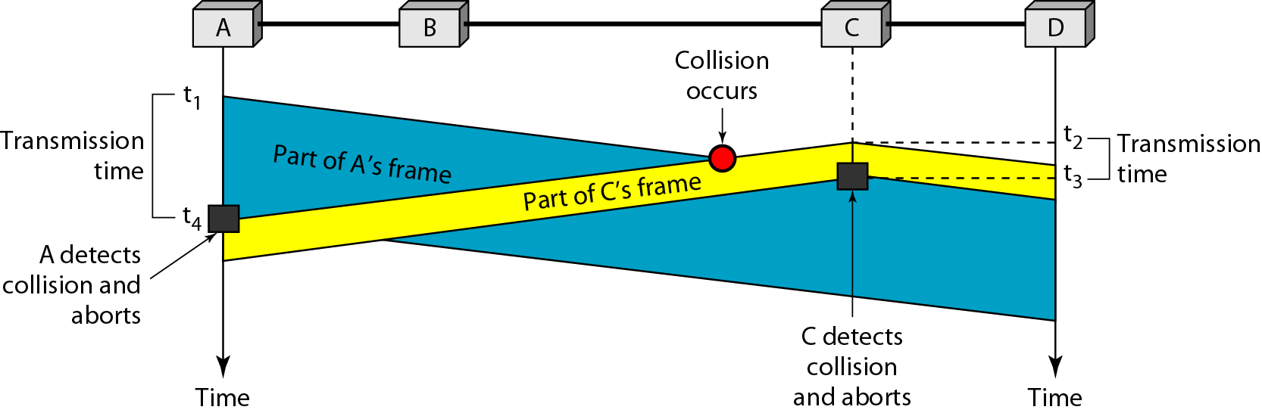
Figure 12.13 Collision and abortion in CSMA/CD

Slide 20
Minimum Frame Size
The frame transmission time T_{fr} must be at least two times the maximum propagation time T_{p}

Slide 21
Example 12.5
A network using CSMA/CD has a bandwidth of 10 Mbps. If the maximum propagation time (including the delays in the devices and ignoring the time needed to send a jamming signal, as we see later) is 25.6 μs, what is the minimum size of the frame?
Solution
The frame transmission time is T_{fr} = 2 × T_{p} = 51.2 μs. This means, in the worst case, a station needs to transmit for a period of 51.2 μs to detect the collision. The minimum size of the frame is 10 Mbps × 51.2 μs = 512 bits or 64 bytes. This is actually the minimum size of the frame for Standard Ethernet.

Slide 22
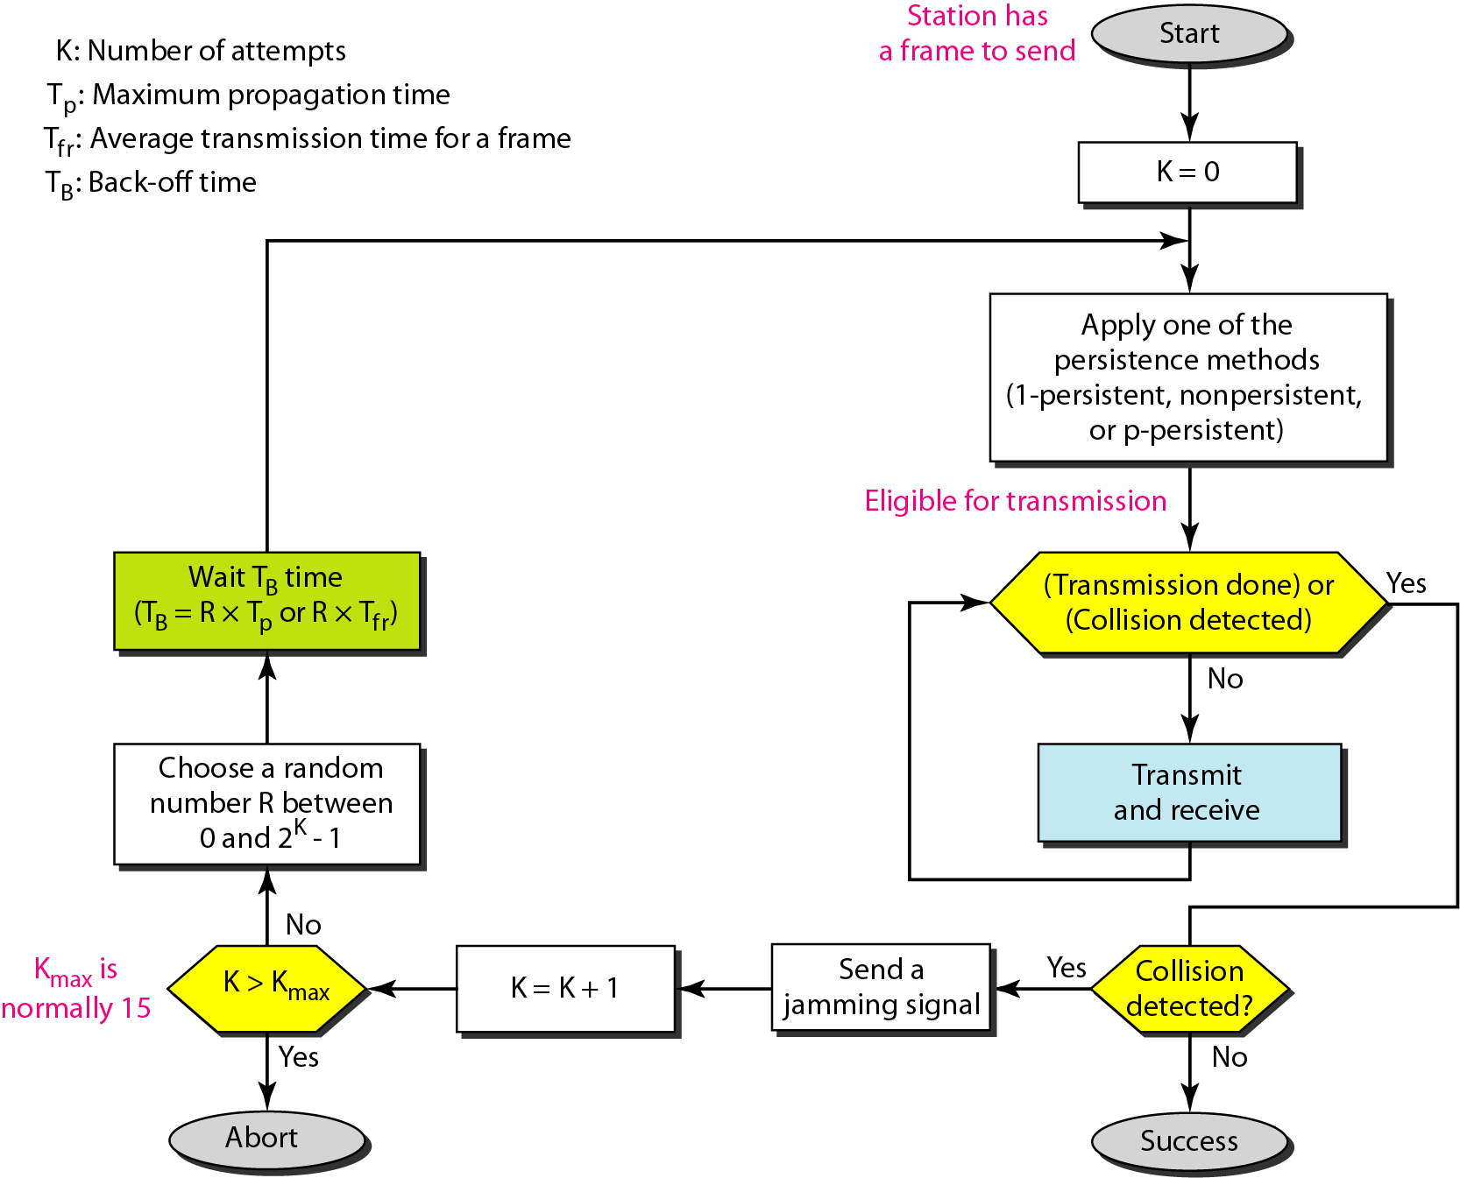
Figure 12.14 Flow diagram for the CSMA/CD

Slide 23
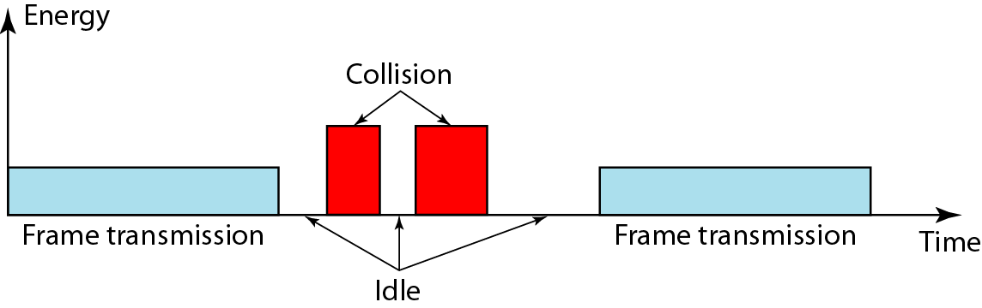
Figure 12.15 Energy level during transmission, idleness, or collision

Slide 24
THE END!

